Slide 1

Blockchain Logistics
Community
Connect | Collaborate | Create

Slide 2
Solution Architecture - Scope
Requirement:
Tracking logistic transaction between one retailer, two manufacturers each one tied up with a logistic provider.
Consortium:
1 Retailer, 2 Manufacturers and 2 Logistic Providers

Slide 3
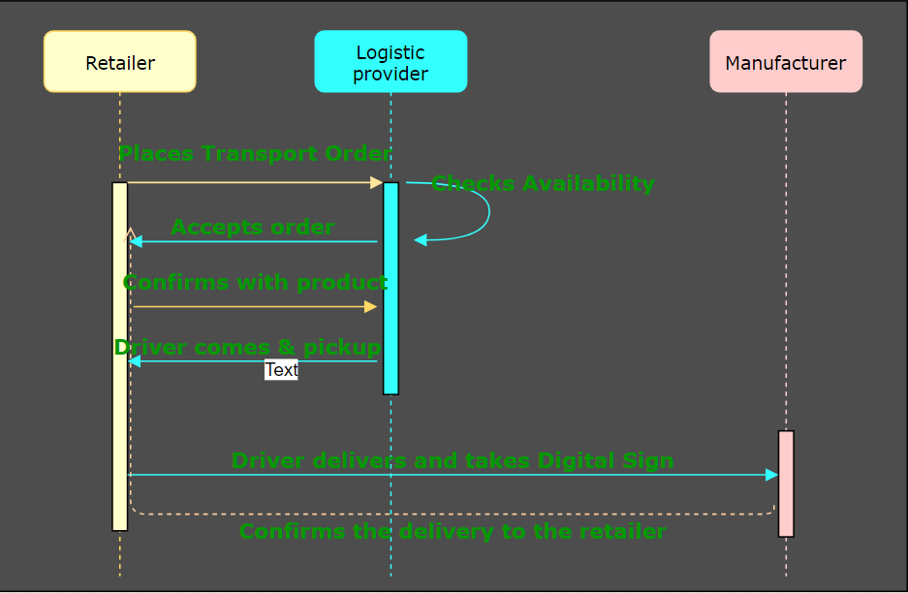
Solution Architecture - Sequence

Slide 4
Solution Architecture – Network Specs
S.No | Component | Qty | Category | Name
1 | Network | 1 | Network | Block Logistics
2 | Orgs | 3 | Participants | Logistics1, Logistics1, Retailer1 , Mfg1, Mfg2
3 | CA | 1 | MSP | Fabric-CA
4 | Channel | 1 | endorsement & State | BlockChannel1
5 | ChainCode | 2 | Logic | Retailer, Driver
6 | Users | 3 | End user and admin | adminNT, userL, userD, userC

Slide 5
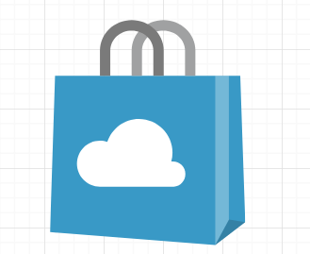
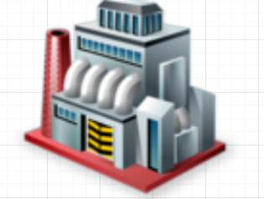
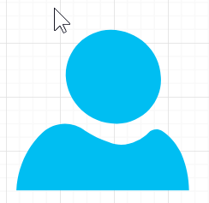
Solution Architecture - Actors
Retailer
Manufacturer
Driver
Actor Attributes: Username, Full Name, Org

Slide 6
Solution Architecture - Assets - Attributes
OrganizationProfile : OrgName, OrgType, Address
UserProfile : UserName, Password, Private Key, Public Key
TransportRecord : TruckNum, DriverName, LogisticOrg, FromOrg,ToOrg, FromAddress, ToAddress, FromLocLat, FromLocLng, ToLocLat, ToLocLng, DeliveryLat, DeliveryLng, DeliveryDtTm, TransportStatus(Pickup, InTransit, Delivered)

Slide 7
Solution Architecture - Transactions
Transaction1

Slide 8
Solution Architecture - Chaincodes
RetailerTransport:
DriverTransport
ManufTransport

Slide 9
Solution Architecture – Technology Stack
S.No | Tool / Framework | Category | Solution Folder
1 | Hyperledger Fabric | Blockchain OS | HLFabric
2 | Chaincode Lang | Go Lang | HLFabric
3 | Configuration type | SHIM type | HLFabric
4 | StateDB | CouchDB(Default) | HLFabric
4 | LedgerDB | GoLevelDB (Default) | HLFabric
5 | Fabric SDK | Node SDK | AppServer
6 | Backend Server Platform | NodeJS | AppServer
7 | REST Engine | ExpressJS | AppServer
8 | Authentication | JWT | AppServer
9 | Front End | Angular, Bootstrap, Android | AppClient

Slide 10
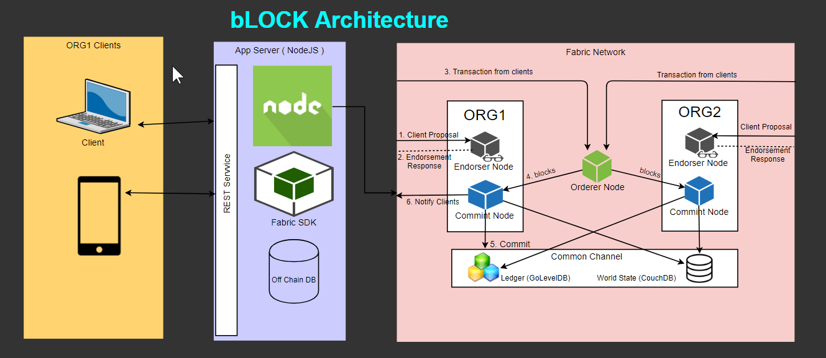
Solution Architecture - Logical

Slide 11


